Slide 1
AIM OF THE PROJECT
Sensor Blind Stick using IOT technology
MEMBERS OF PROJECT AND ROLL NUMBERS
A.Reethika – 23H71A1201
G.V.Akhila -23H71A1212
G.Dola Siva Shankar-23H71A1213
G.Karthik-23H71A1217
P.Pooja Sri-23H71A1245
T.Karthik-23H71A1257

Slide 2


Slide 3


Slide 4
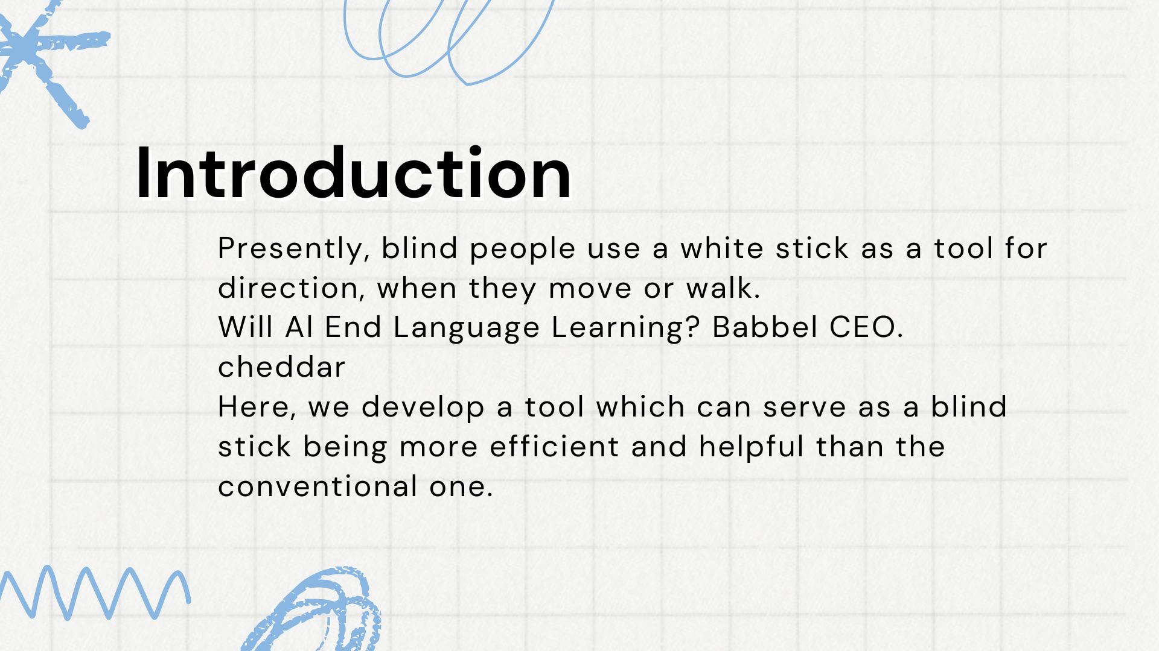

Slide 5
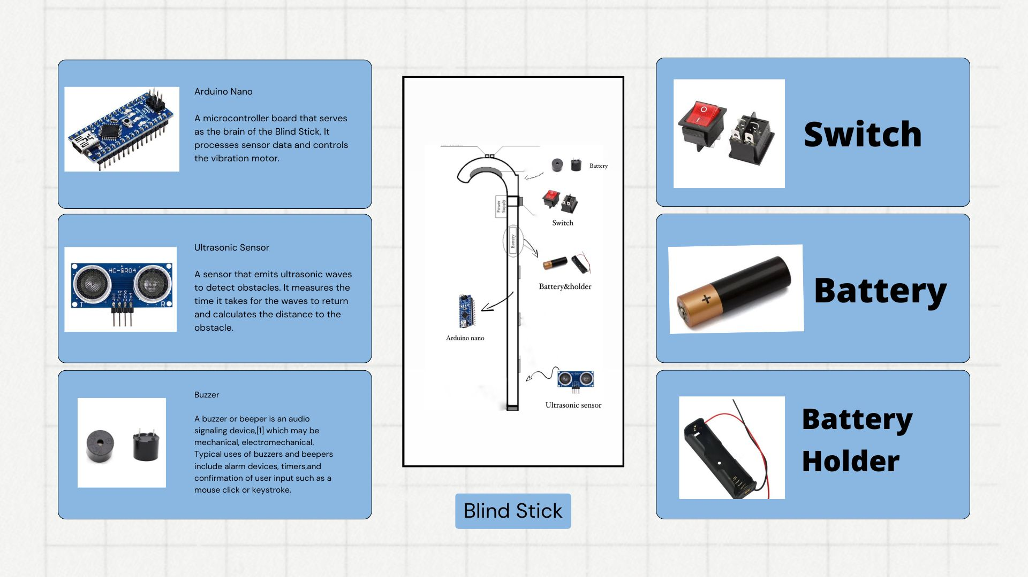

Slide 6
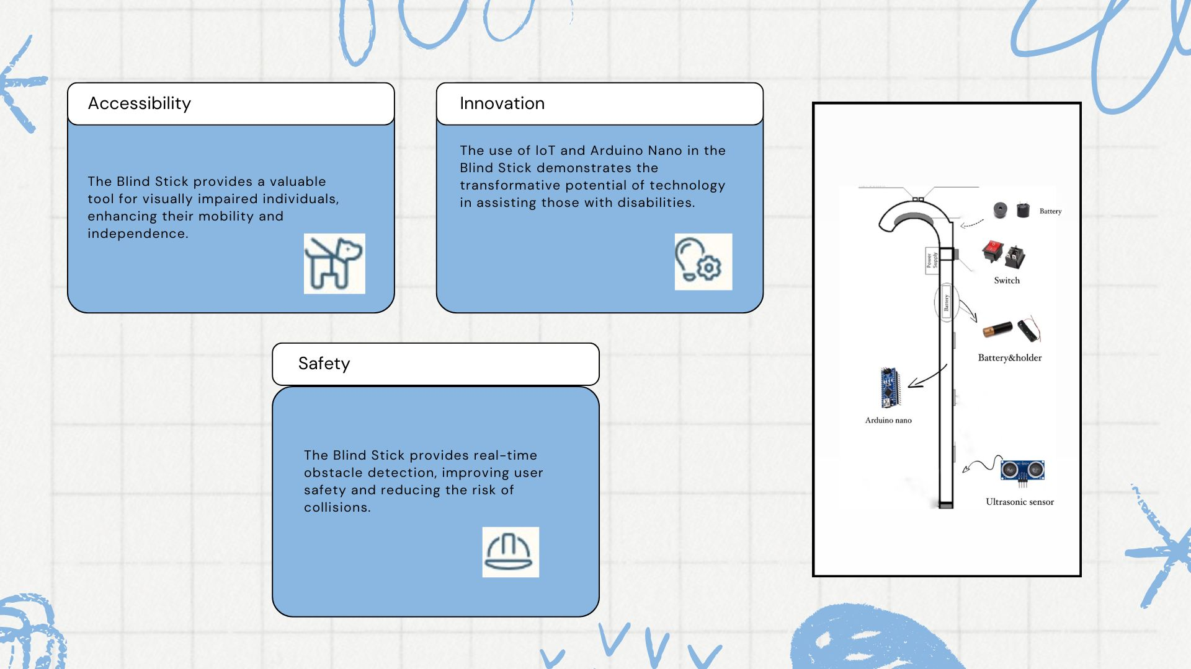

Slide 7
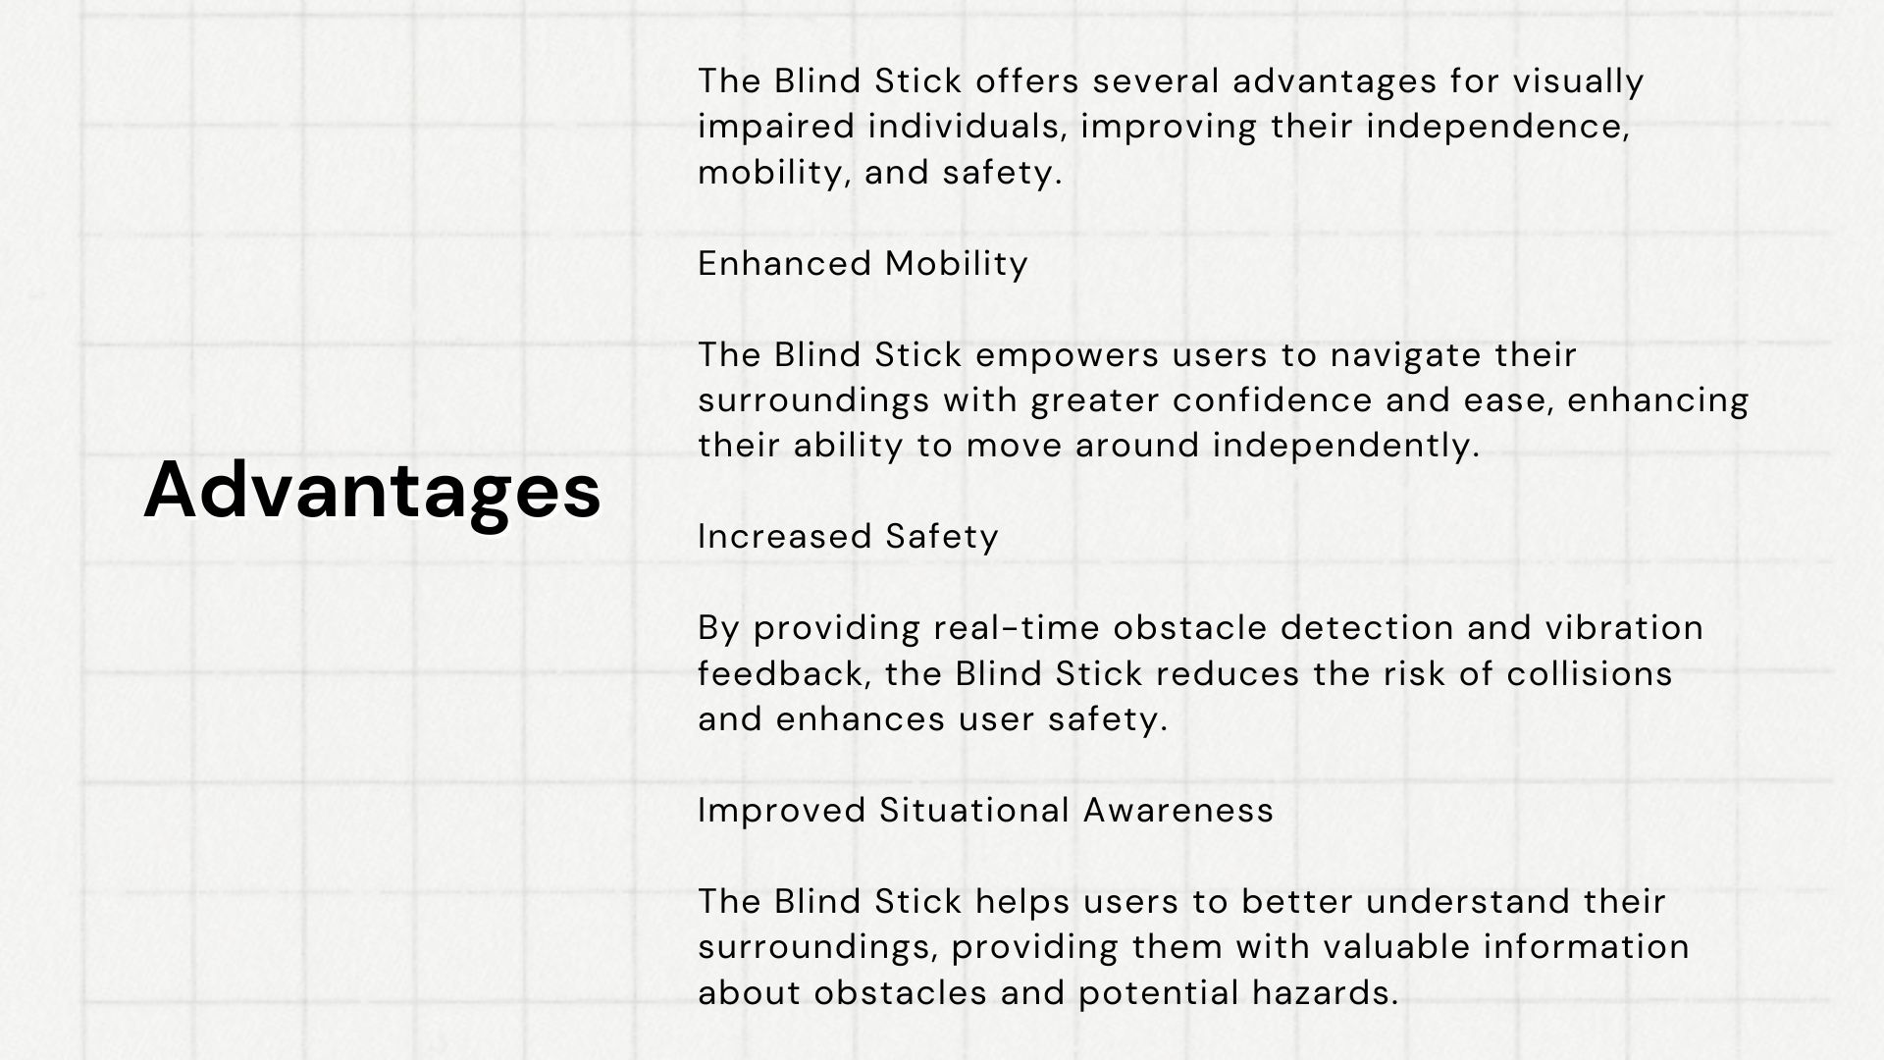

Slide 8
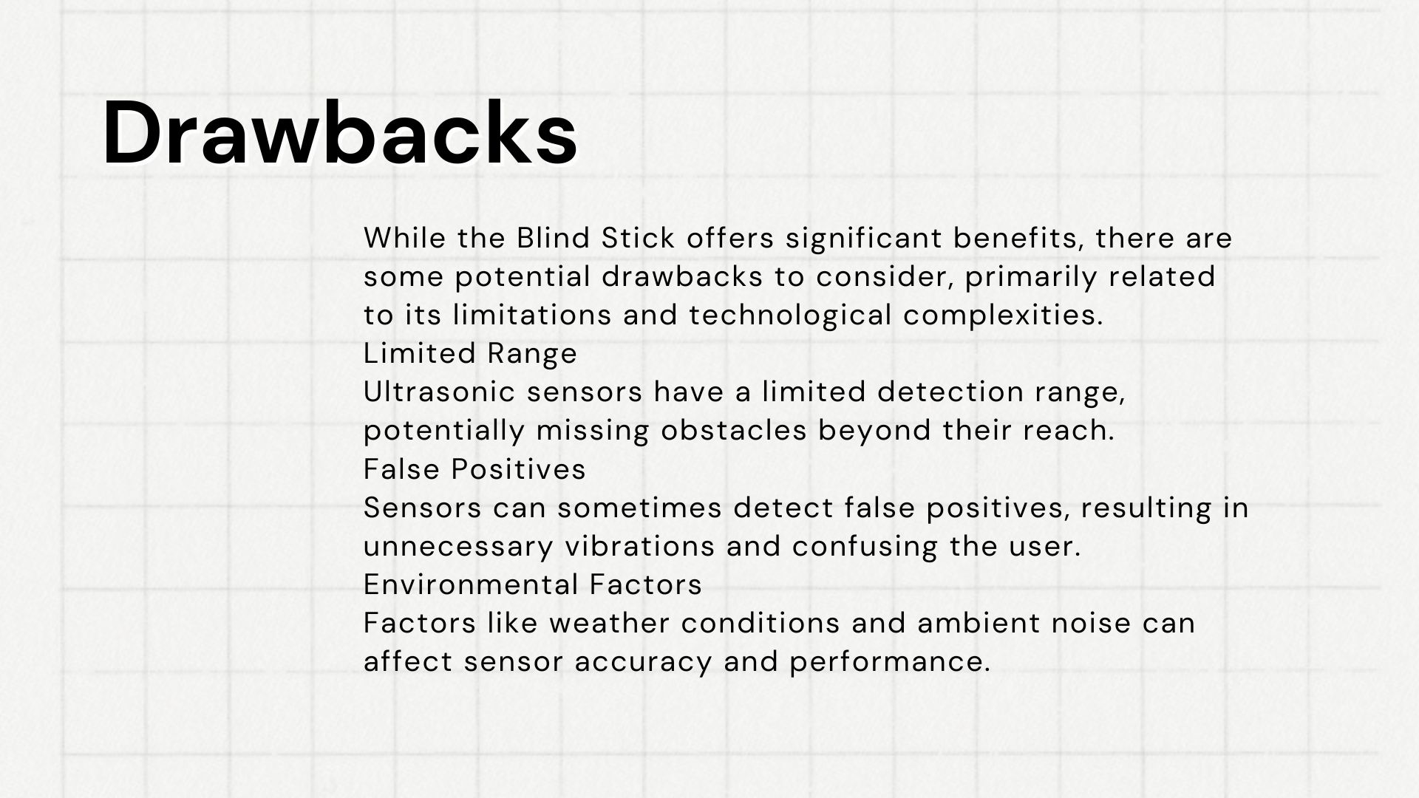

Slide 9
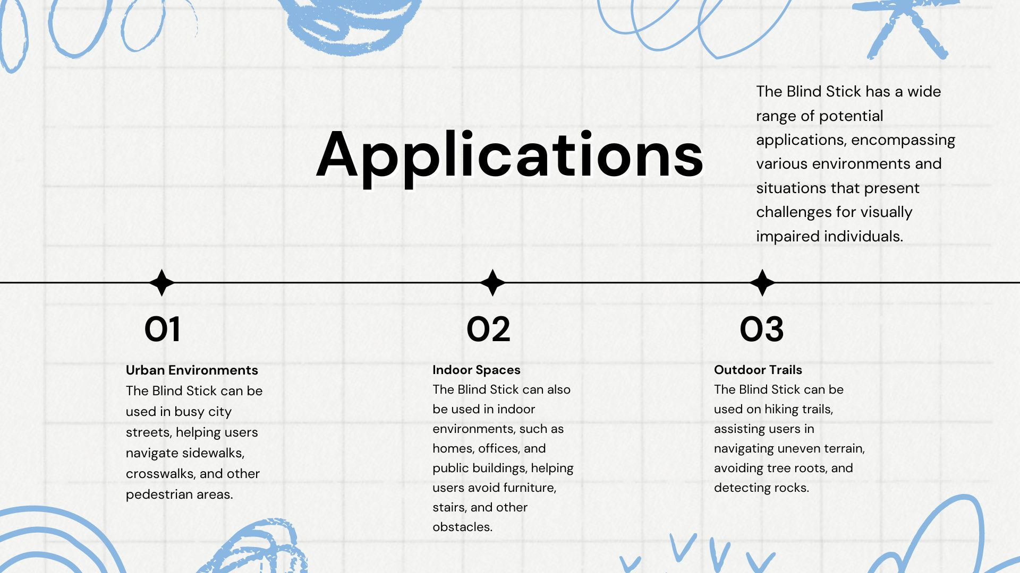

Slide 10
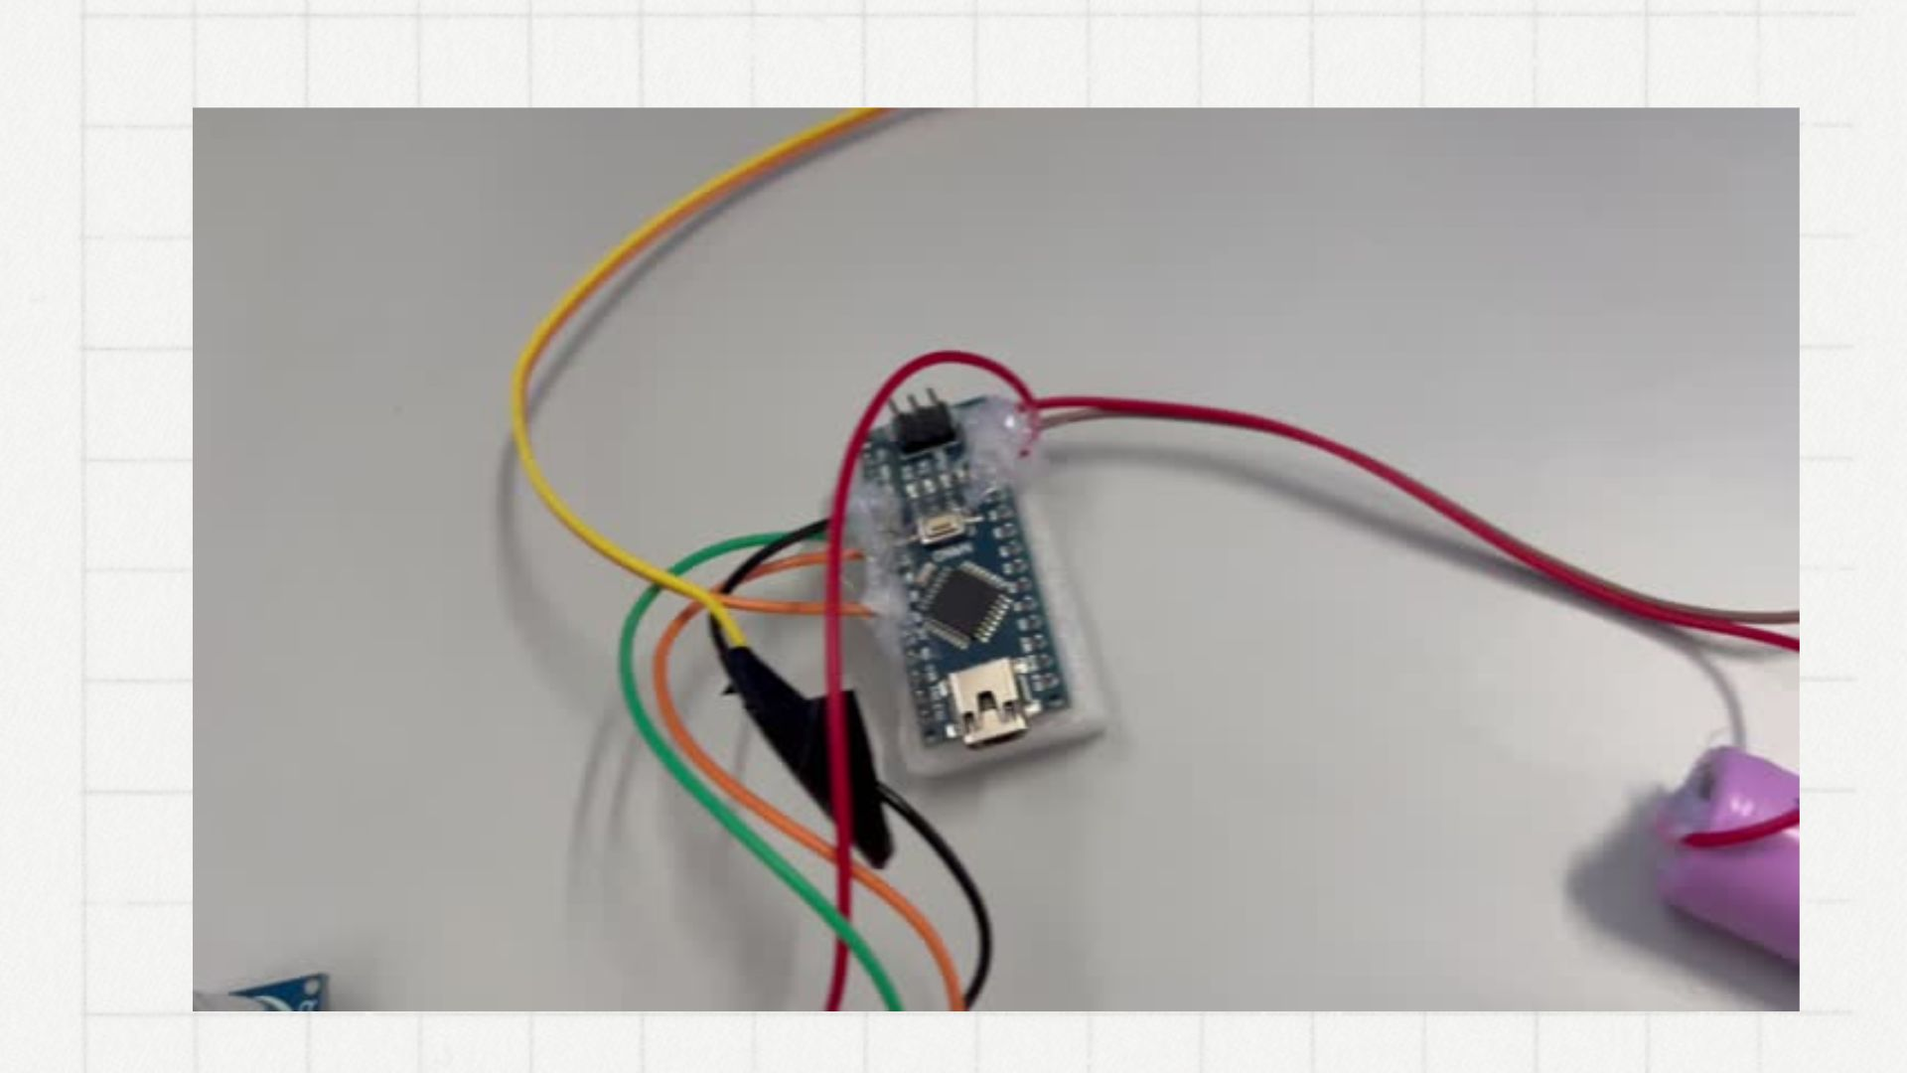

Slide 11
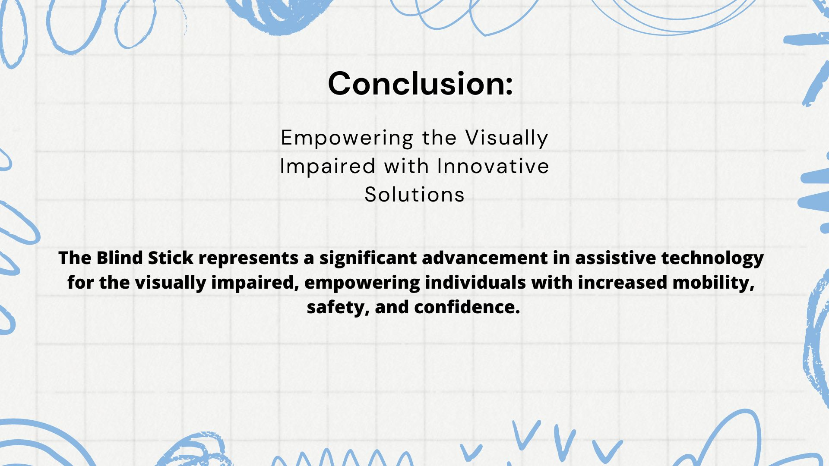

Slide 12


